Slide 1

Dissertation Stage – 1 Presentation
Transforming Sentimental Analysis: Applying Deep Learning with BERT and GPT for Twitter Data Insights
By –
Varma Manthankumar Shaileshkumar
712352045
Guided by
Prof. Soma Ghosh
Department of Computer Science and Engineering
COEP Technological University
A Unitary Public University of Govt. of Maharashtra
Formerly College of Engineering Pune

Slide 2
Index
Introduction
Literature Survey
Motivation for Study
Problem Statement
Research Objectives
Software Requirement Specification
Future Plan
References
COEP Technological University
A Unitary Public University of Govt. of Maharashtra
Formerly College of Engineering Pune

Slide 3
Introduction
Social media platforms, particularly Twitter, have become powerful channels for individuals to express their emotions and opinions[3]. The rapid increase in the volume of tweets presents both an opportunity and a challenge for understanding public sentiment. Leveraging deep learning techniques, especially models like BERT and GPT, enables a nuanced analysis of the emotional tone and opinions conveyed in these tweets. Unlike traditional sentiment analysis methods, which often simplify sentiments into binary classifications, these advanced models can capture the complexities of language, context, and intent inherent in social media conversations[2].
By employing BERT and GPT, this project aims to provide more accurate insights into public opinion on various subjects, including current events, products, and social issues. The analysis goes beyond merely categorizing tweets as positive, negative, or neutral[1]; it seeks to uncover deeper sentiment trends over time. This approach allows for the identification of shifts in public mood and the emergence of new themes, offering valuable data for decision-making in fields such as marketing, politics, and social research.
COEP Technological University
A Unitary Public University of Govt. of Maharashtra
Formerly College of Engineering Pune

Slide 4
Literature Survey
Title | Year | Methodology | Research Gap | Author
Sentimental analysis of twitter data using machine learning algorithms[5] | 2021 | Logistic Regression, Linear SVC, Random Forest Classifier, KNN | Existing approaches often rely on basic classification methods, which may not fully capture the complexity of emotions expressed in tweets, indicating a potential for improved accuracy and insights. | G. Prema Arokia Mary, M. S. Hema, R. Maheshprabhu, and M. Nageswara Guptha
Crime prediction using Twitter sentiment and weather[1] | 2023 | GPS-Tagged Twitter data, Kernel density estimation, Linear modeling | By failing to account for the emotional context of tweets and environmental conditions, current models overlook critical predictors that could enhance the accuracy of crime forecasting | X. Chen, Y. Cho, and S. Y. Jang
Advanced NLP techniques for efficient sentiment analysis of us airline twitter data[3] | 2024 | Pre-trained RoBERTa model, fastText classifier | While existing methods address sentiment classification, they often overlook the integration of diverse data sources and nuanced sentiment insights | S. A. Sazan, M. Ahmed, T. B. Saad, and M. Roy
COEP Technological University
A Unitary Public University of Govt. of Maharashtra
Formerly College of Engineering Pune

Slide 5
Literature Survey
Title | Year | Methodology | Research Gap | Author
Question answering system for healthcare information based on bert and gpt[1] | 2023 | BERT, GPT-2, Intellectual Q&A pairs | The research gap in this study lies in the underutilization of advanced natural language processing techniques, specifically the integration of BERT and GPT-2, for automating healthcare-related question-and-answer systems | S. W. Jeong, C. G. Kim, and T. K. Whangbo
Exhibiting the explicit aspects in twitter sentimental data[1] | 2023 | Sentiment Analysis, NLP, ML Techniques | These methods often overlook the complexities of emotional states, highlighting the need for comprehensive approach that enhance the accuracy of sentiment interpretation. | S. Jayanthi and S. S. Arumugam
COEP Technological University
A Unitary Public University of Govt. of Maharashtra
Formerly College of Engineering Pune

Slide 6
Motivation for Study
The motivation behind this study lies in the need to explore and harness state-of-the-art deep learning models such as BERT and GPT for sentiment analysis[3]. Traditional machine learning algorithms, while effective, often fall short when dealing with the complexities of natural language, especially in social media contexts where sarcasm, slang, and evolving trends complicate the interpretation of sentiment. By leveraging the power of BERT and GPT, which have revolutionized natural language understanding, this project aims to improve the accuracy and depth of sentiment analysis for Twitter data[1]
Specifically, the project’s goal is to investigate the differences in performance between BERT and GPT, two leading transformer-based models, and compare their ability to classify sentiments accurately. The motivation also extends to understanding how these models can be applied in real-time scenarios where businesses, political analysts, and other stakeholders can derive actionable insights from the sentiment expressed on Twitter[5].
COEP Technological University
A Unitary Public University of Govt. of Maharashtra
Formerly College of Engineering Pune

Slide 7
Problem Statement
The problem this study addresses is twofold:
Comparative Evaluation: Evaluate the performance of BERT and GPT in classifying sentiment on Twitter data, considering the platform’s unique linguistic challenges.
Model Effectiveness: Determine which model provides more accurate and contextually relevant sentiment analysis, and identify the conditions under which one outperforms the other. [7]
This study aims to provide insights into selecting the most effective model for Twitter based sentiment analysis, contributing to both academic research and practical applications in industries relying on real-time sentiment analysis for decision-making.
COEP Technological University
A Unitary Public University of Govt. of Maharashtra
Formerly College of Engineering Pune

Slide 8
Research Objectives
The specific research objectives are as follows:
To analyze the performance of BERT and GPT in sentiment classification: This objective focuses on assessing the accuracy, precision, recall, and overall effectiveness of both models in classifying sentiments (positive, negative, or neutral) from Twitter data.
To identify challenges in applying BERT and GPT for social media sentiment analysis: This involves investigating the limitations and difficulties of using these models on informal, unstructured text such as tweets, including issues related to sarcasm, slang, and real-time trends.
To compare the strengths and weaknesses of BERT and GPT for sentiment analysis: This objective aims to determine the specific scenarios where one model outperforms the other, highlighting factors such as dataset size, text length, and the complexity of sentiment expressions
COEP Technological University
A Unitary Public University of Govt. of Maharashtra
Formerly College of Engineering Pune

Slide 9
Research Objectives
The specific research objectives are as follows:
4. To provide recommendations for improving sentiment analysis using BERT and GPT: Based on the findings, this objective seeks to offer practical guidelines for future implementations, optimizing model selection and usage for social media sentiment analysis tasks[9].
To contribute to the broader field of natural language processing: The final objective is to enhance understanding of transformer-based models in NLP applications, particularly for real-world, real-time data analysis in highly dynamic environments like Twitter.
By achieving these objectives, this study aims to advance the application of transformer-based models in sentiment analysis, providing deeper insights into their capabilities and limitations.
COEP Technological University
A Unitary Public University of Govt. of Maharashtra
Formerly College of Engineering Pune

Slide 10
Software Requirements Specification
Function Requirements:
1. Data Collection:
• Twitter API or dataset repository (e.g., Kaggle) for extracting relevant tweets.
• Scripts for data preprocessing, cleaning, and formatting.
2. Sentiment Classification:
• Pre-trained BERT and GPT models for fine-tuning on Twitter data.
• Training algorithms to classify sentiment (positive, negative, neutral).
3. Performance Evaluation:
• Functions to calculate model performance metrics: accuracy, precision, recall, and F1-score.
COEP Technological University
A Unitary Public University of Govt. of Maharashtra
Formerly College of Engineering Pune

Slide 11
Software Requirements Specification
Hardware Requirements:
1. Processor: A multi-core processor (Intel i5 or higher) for efficient computation.
2. Ram: Minimum of 16 GB, with 32 GB or more recommended for handling largescale data and model training.
3. GPU: NVIDIA GPU with CUDA support (e.g., NVIDIA Tesla T4 or better) for faster model training.
4. Storage: At least 100 GB of available disk space for storing datasets, models, and outputs.
Software Requirements:
• Ubuntu 20.04 LTS (Linux preferred for compatibility with deep learning libraries).
• Alternatively, Windows 10 or macOS.
• Python 3.8 or higher, as it supports necessary libraries for NLP and machine learning.
COEP Technological University
A Unitary Public University of Govt. of Maharashtra
Formerly College of Engineering Pune

Slide 12
Software Requirements Specification
Libraries and Framework:
• Transformers (Hugging Face): For pre-trained BERT and GPT models.
• TensorFlow 2.x or PyTorch: For model training and fine-tuning.
• Pandas and NumPy: For data manipulation and processing.
• Scikit-learn: For calculating performance metrics like accuracy, precision, recall, and F1-score.
• NLTK or spaCy: For additional text preprocessing tasks (e.g., tokenization, stopword removal).
• Matplotlib or Seaborn: For visualizing performance comparisons and data distributions
Performance Requirements:
The system should be able to process at least 100,000 tweets within a reasonable time frame (under 30 minutes) with acceptable performance. Inference time for sentiment prediction should be optimized to handle real-time analysis with minimal latency.
COEP Technological University
A Unitary Public University of Govt. of Maharashtra
Formerly College of Engineering Pune

Slide 13
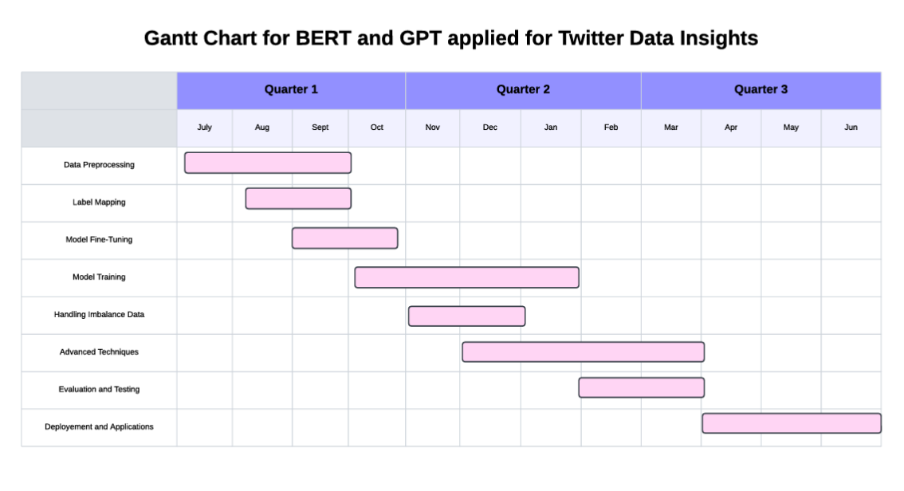
Future Plan
COEP Technological University
A Unitary Public University of Govt. of Maharashtra
Formerly College of Engineering Pune

Slide 14
References:
N. N. Reddy, E. Naresh, and V. Kumar B.P., “Predicting stock price using sentimental analysis through twitter data,” in 2020 IEEE International Conference on Electronics, Computing and Communication Technologies (CONECCT), pp. 1–5, 2020.
N. Vallileka, P. Sundaravadivel, U. Karthikeyan, R. S. Krishnan, K. L. Narayanan, and S. Sundararajan, “Deeptweet: Leveraging transformer-based models for enhanced fake news detection in twitter sentiment analysis,” in 2023 7th International Conference on I-SMAC (IoT in Social, Mobile, Analytics and Cloud) (I-SMAC), pp. 438–443, 2023.
P. Singh, B. Jain, and K. Sinha, “Evaluating bert and gpt-2 models for personalised linkedin post recommendation,” in 2023 14th International Conference on Computing Communication and Networking Technologies (ICCCNT), pp. 1–7, 2023.
S. Jayanthi and S. S. Arumugam, “Exhibiting the explicit aspects in twitter sentimental data,” in 2023 International Conference on Data Science, Agents Artificial Intelligence (ICDSAAI), pp. 1–6, 2023.
COEP Technological University
A Unitary Public University of Govt. of Maharashtra
Formerly College of Engineering Pune

Slide 15
References:
S. W. Jeong, C. G. Kim, and T. K. Whangbo, “Question answering system for healthcare information based on bert and gpt,” in 2023 Joint International Conference on Digital Arts, Media and Technology with ECTI Northern Section Conference on Electrical, Electronics, Computer and Telecommunications Engineering (ECTI DAMT NCON), pp. 348–352, 2023.
S. A. Sazan, M. Ahmed, T. B. Saad, and M. Roy, “Advanced natural language processing techniques for efficient sentiment analysis of us airline twitter data: A high-performance framework for extracting insights from tweets,” in 2024 6th International Conference on Electrical Engineering and Information Communication Technology (ICEEICT), pp. 01–06, 2024.
G. Prema Arokia Mary, M. S. Hema, R. Maheshprabhu, and M. Nageswara Guptha, “Sentimental analysis of twitter data using machine learning algorithms,” in 2021 International Conference on Forensics, Analytics, Big Data, Security (FABS), vol. 1, pp. 1–5, 2021.
COEP Technological University
A Unitary Public University of Govt. of Maharashtra
Formerly College of Engineering Pune

Slide 16
Thank You!
COEP Technological University
A Unitary Public University of Govt. of Maharashtra
Formerly College of Engineering Pune

